Slide 1
Information Visualization Session 2: Asking the Question / Analyzing the Data

Slide 2
Agenda
Finding the appropriate data
Organize / analyze your data
Basic charting

Slide 3
Agenda
Excel is your new best friend

Slide 4




Demographic Data
Census.gov/data.html
IPUMS
Bureau of Labor Statistics
data.un.org

Slide 5
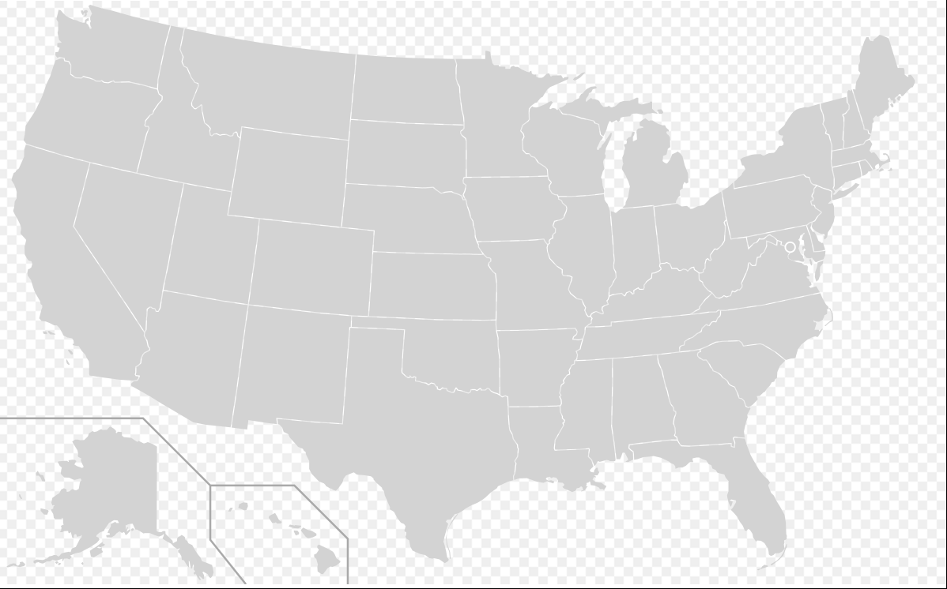
Location Data
Wikipedia SVG Maps
TIGER (KML, Shapefiles)
https://www.census.gov/geo/maps-data/data/tiger.html

Slide 6


News Data
ProPublica
New York Times APIs

Slide 7



Hand-Built Data
Data in PDF or white papers
Requires moving the data by hand to a spreadsheet program

Slide 8
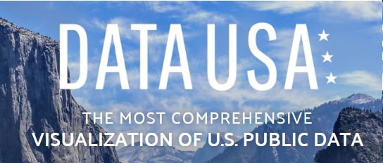

All The Data
datausa.io
Awesome Public Datasets
(github)
Berkeley Data Lab
Data.gov

Slide 9
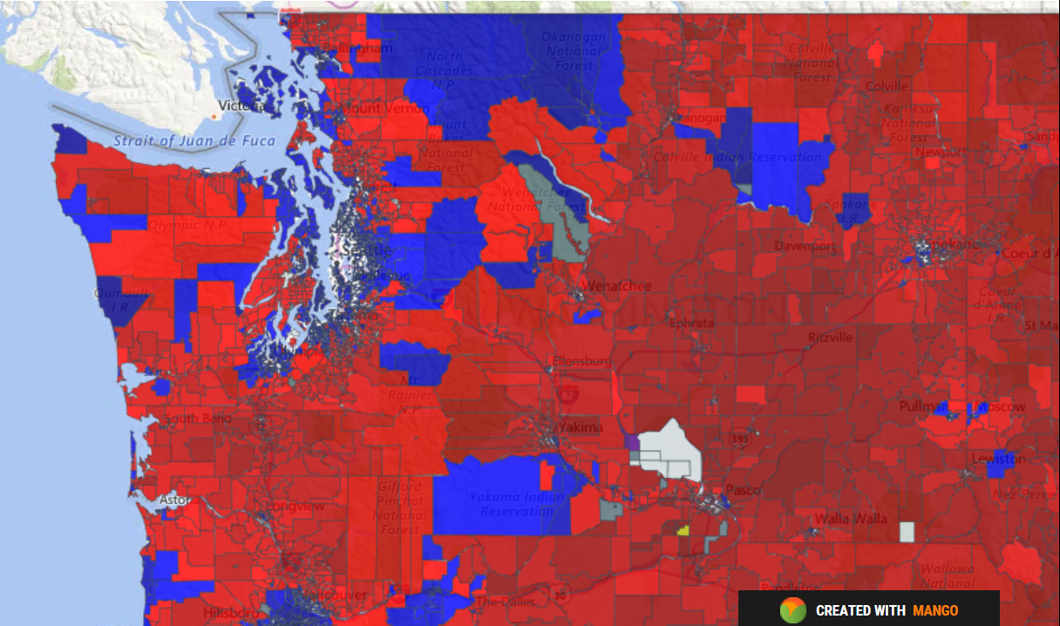
Location Data
Ryne Rohla
Washington State
Decision Desk HQ
https://decisiondeskhq.com/

Slide 10
pick a topic for your story

Slide 11
Start With a Topic
Education
Finance
Demographics
Polling
Elections

Slide 12
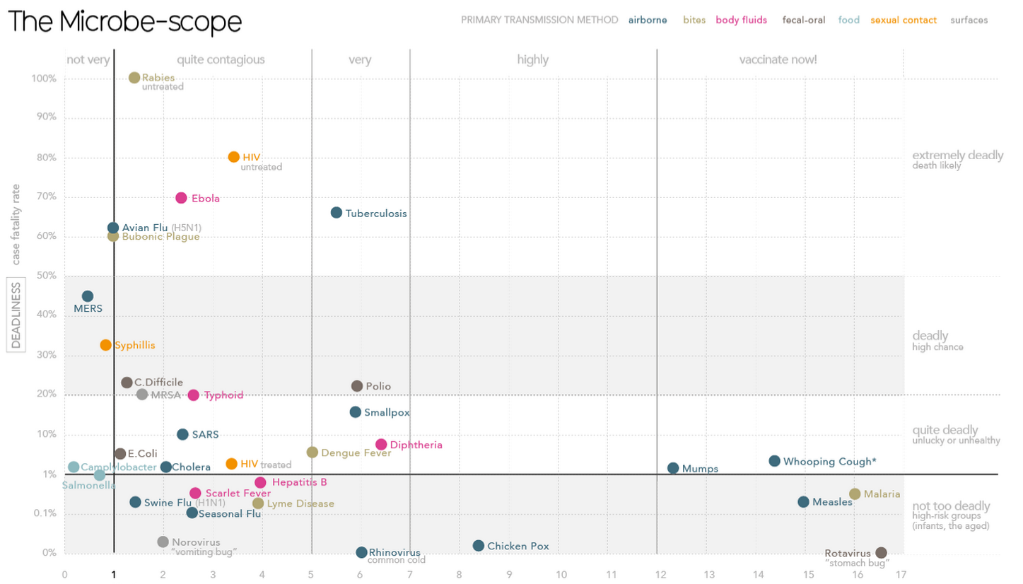
Start With the Data You Can Find
Working with existing data will raise questions
You may have to collect the “missing link”
http://www.informationisbeautiful.net/
visualizations/the-microbescope/

Slide 13
Start With the Data You Can Find
Notes:
David McCandless built this visualization to show how contagious various microbes were vs. how likely we are to die from them. He was able to fine the deadliness fairly easily, but the contagion of the microbes is based on the “basic reproduction number” which is the number of additional cases of a disease that result from an initial case of the disease. Unfortunately, this information is now published cleanly, so he had to go deep into a lot of research in order to discover and extract the data that he wanted to visualize.

Slide 14
find the data

Slide 15
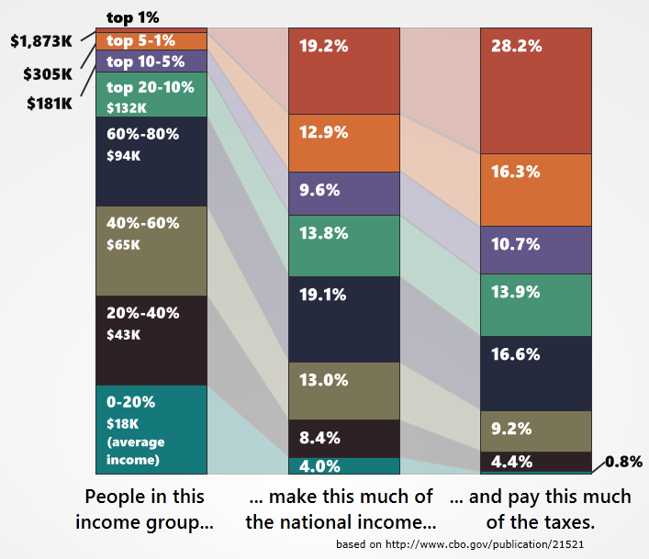
Economic Data
FRED – Federal Reserve Bank
of St. Louis Economic Data
http://research.stlouisfed.org/
CBO.gov
http://www.cbo.gov/
http://politicalmathblog.com/?p=1735

Slide 17
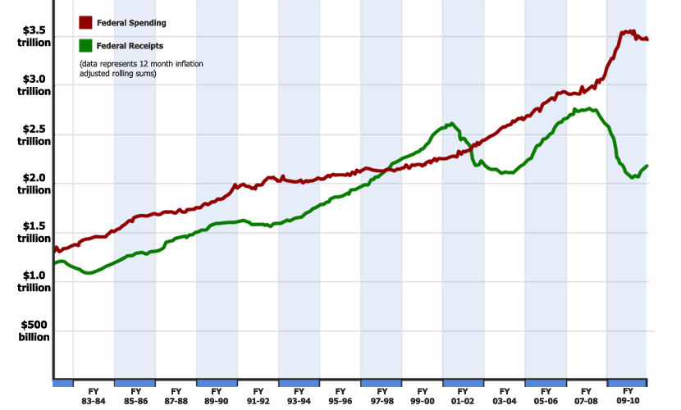
Federal Spending Data
Monthly Treasury
Statement
http://www.fiscal.treasury.gov/
fsreports/rpt/mthTreasStmt/
backissues.htm
CBO.gov
http://www.cbo.gov/

Slide 18
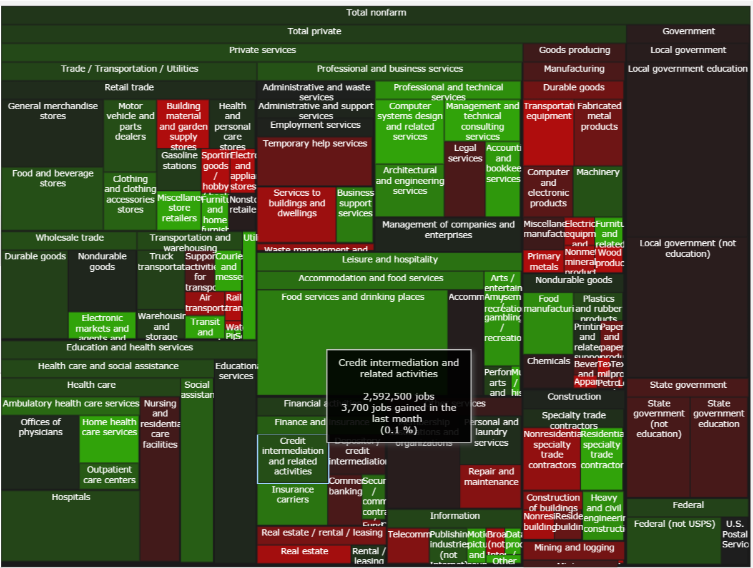
Employment Data
Bureau of Labor Statistics
http://www.bls.gov/data/
http://politicalmathblog.com/BLS/2012/08/
Notes:
Treemap

Slide 19
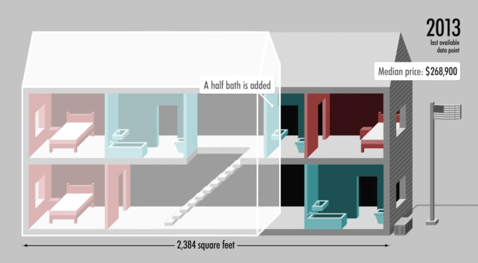
Demographics Data
Census.gov
http://www.census.gov/
data.html
http://money.cnn.com/interactive/pf/40-years-american-home/

Slide 20
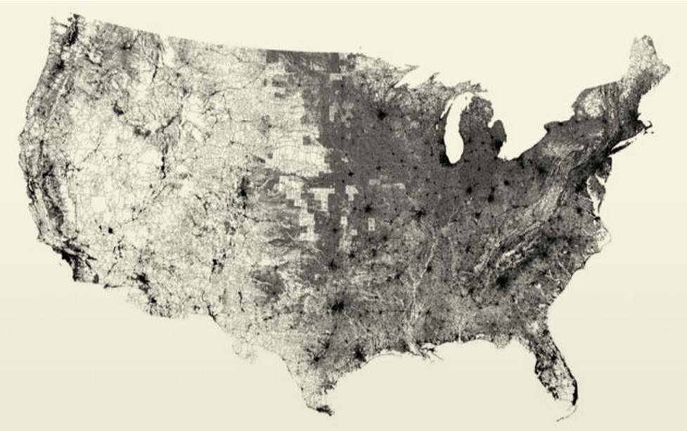
All the Data
https://www.data.gov/open-gov/

Slide 21
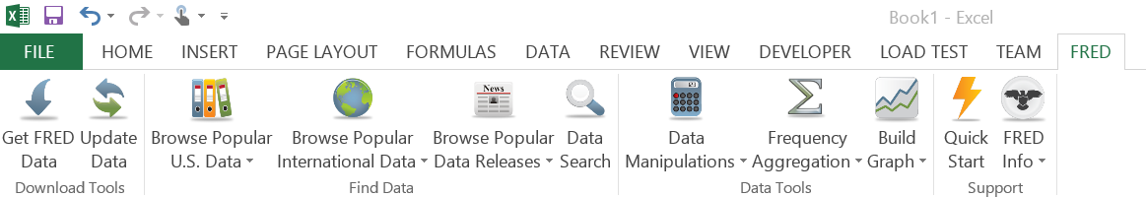
FRED Data – Excel Add-In
http://research.stlouisfed.org/fred-addin/

Slide 22
FRED Data – Excel Add-In
http://research.stlouisfed.org/fred-addin/
DEMO

Slide 23
APIs
http://www.opensecrets.org/resources/create/
http://developer.nytimes.com/docs
http://sunlightfoundation.com/api/

Slide 24
organizing your data

Slide 25
Organize In Excel
Calculating an average
Rolling averages
Transposing data
Copying values (not equations)
Sorting with Excel
Basic conditional investigation

Slide 26
Calculate an Average
=AVERAGE(B1:B12)
Demo

Slide 27
Calculate “per unit” values
[very large number] / [unit]
Example:
Federal spending =per_day/24 =per_minute/60
=spending/365 =per_hour/60

Slide 28
Calculate “per unit” values
[very large number] / [unit]
Example:
Federal spending =spending/households
=spending/population =spending/employed

Slide 29
Rolling Sums / Averages
On sequential data (daily, weekly, monthly)
=SUM(B1:B12)
drag the formula down using handles

Slide 30
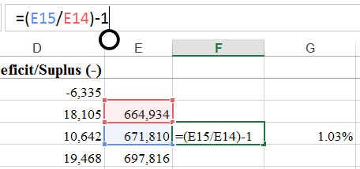
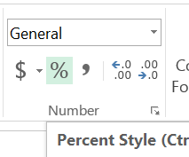
Calculating Percentages
Relative changes often more meaningful than absolute changes
=(A3/A2)-1
“%” formatting
Increase / decrease
significant digits

Slide 31
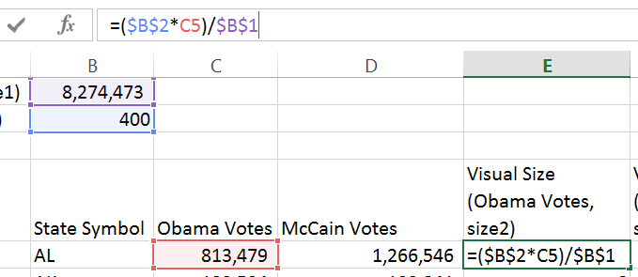
Excel Syntax
Using the ‘$’ operand.
‘$’ means “stop moving”

Slide 32
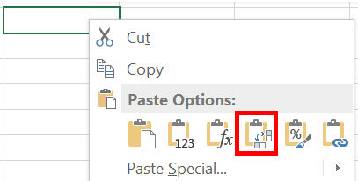
Transposing Data
Copy-Paste data to swap rows/columns

Slide 33
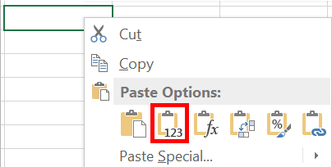
Copying Values
Strip out formulas from cells
Retain only the calculated values
Valuable for moving data from sheet to sheet

Slide 34
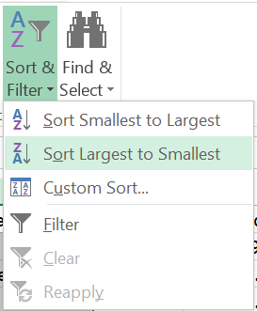
Sorting in Excel
Select a column
“Sort & Filter”
Always “expand selection”

Slide 35
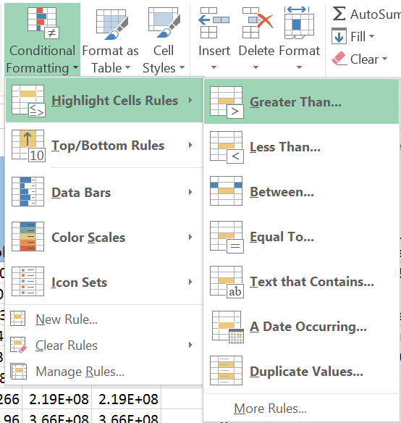
Conditional Investigation
Highlight cells with certain data

Slide 36
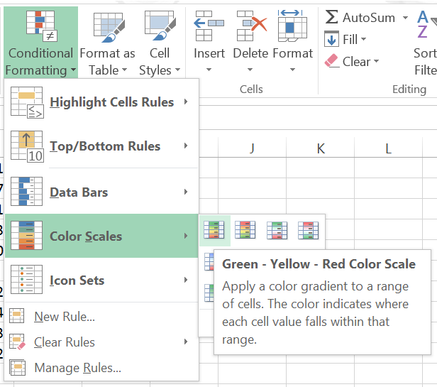
Conditional Investigation
Using Color Scales

Slide 37
basic charting

Slide 38
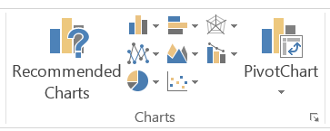
Simple Excel charting
Frequent starting point for a data visualization
Good for data exploration
Different styles reveal different stories

Slide 39
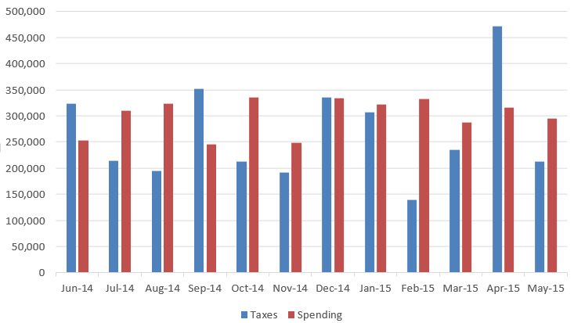
Simple bar chart
Height or length to show scale

Slide 40
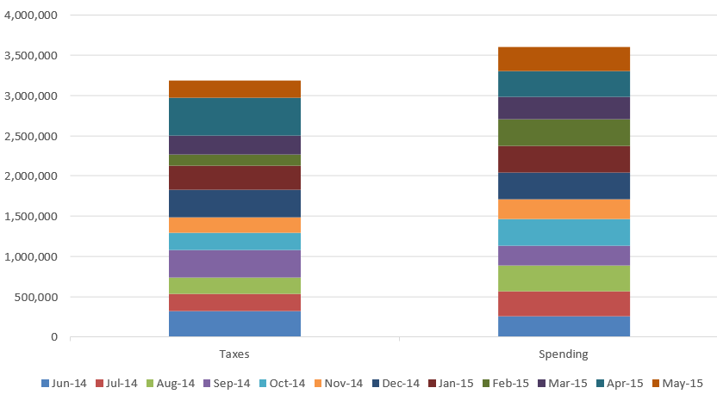
Additive charts
Values stack on
each other
Used to show all parts of a sum

Slide 41
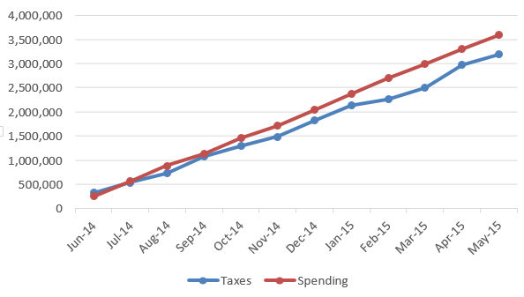
Line Charts
Simple and clean
Excellent for indicating trend lines in data

Slide 42
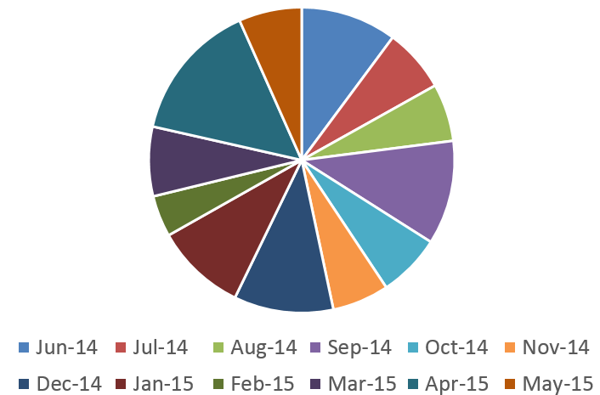
Pie Charts
Show parts of a whole
Keep it to very few parts
Often despised

Slide 43
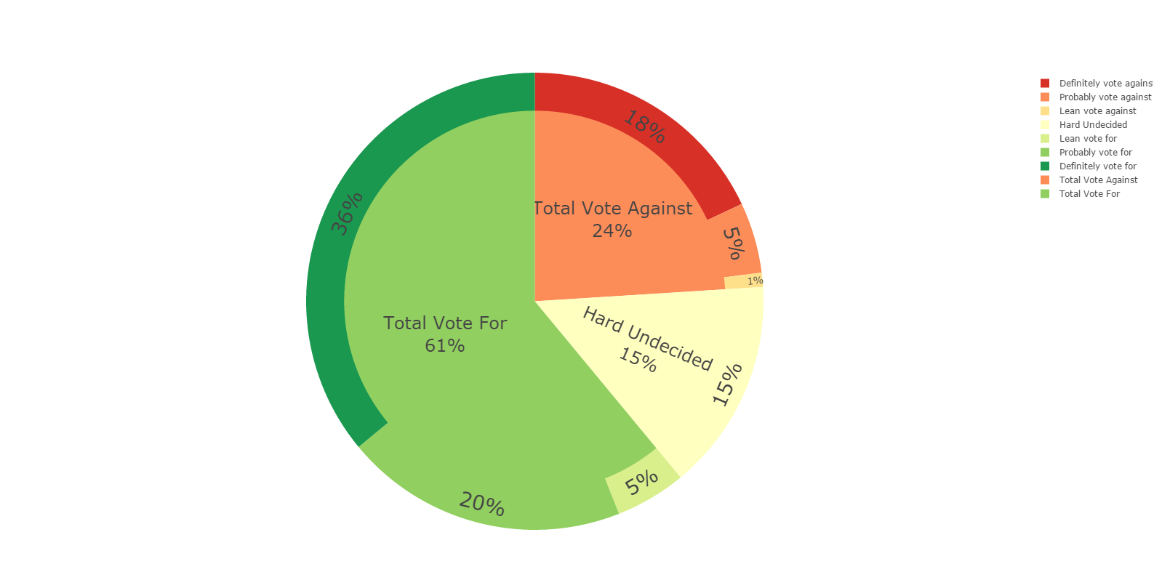
Pie Charts
Permutations of pie charts can be valuable for some data
Best for data that adds up to 100%

Slide 44
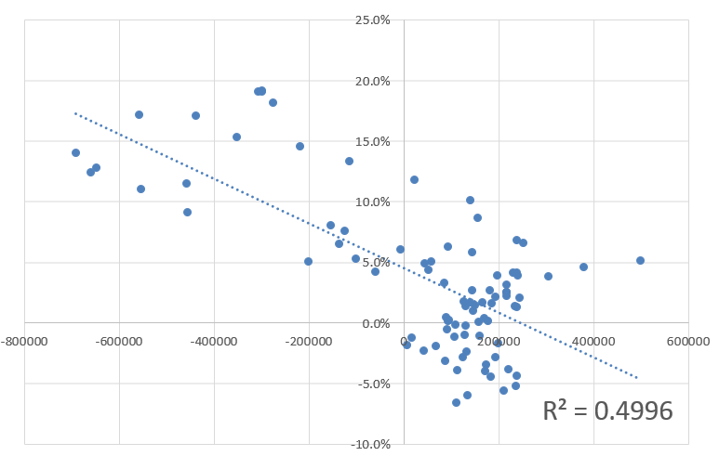
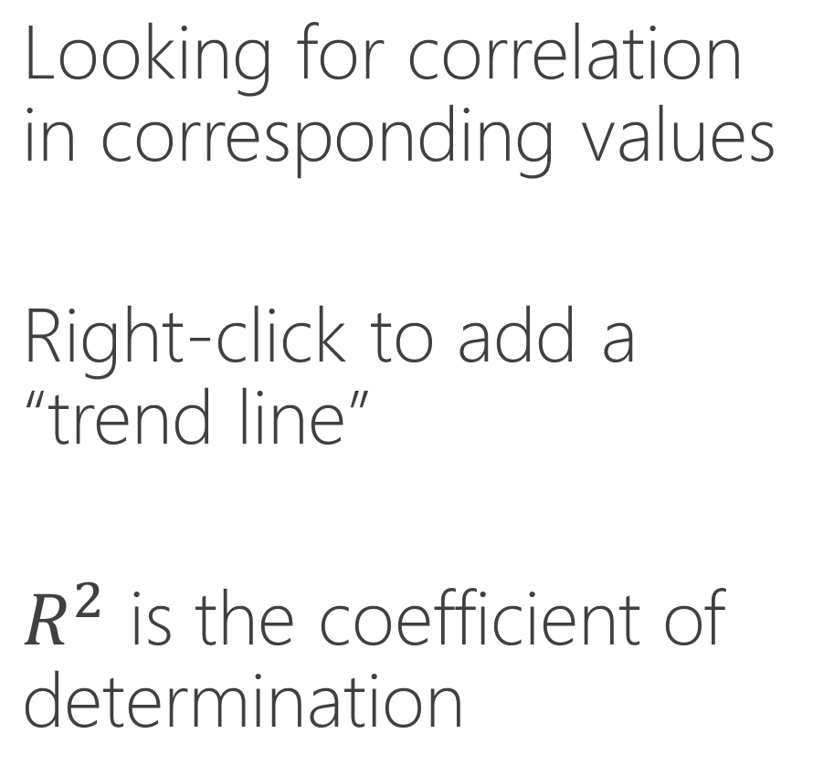
Multi Variate Charts
Looking for correlation in corresponding values
Right-click to add a “trend line”
$R^{2}$ is the coefficient of determination

Slide 45
Multi Variate Charts
Looking for correlation in corresponding values
Right-click to add a “trend line”
$R^{2}$ is the coefficient of determination

Slide 46
Lab 2
Pull jobs data from BLS
Organize multi-sheet data set
Visualize within Excel
Relative vs. Absolute differences

